Slide 1

COMPARITIVE STUDY ON FLOWER POLLINATION ALGORITHM AND OPTIMAL LINEAR WEIGHTED ALGORITHM
IN COGNITIVE RADIO NETWORK
Internal Guide : Mrs. R. Lakshmi, M.E
Assistant Professor,
ECE Department
Presented by : Yuvashree.B
Snehashree.G
Roshni.R

Slide 2

INTRODUCTION
Wireless communication takes place over free space over RF (Radio Frequency), where a transmitter sends a signal to receiver. Here both the transmitter and receiver must use the same frequency or channel to communicate with each other.
A cognitive radio (CR) is a radio that can be programmed and configured dynamically to use the best channels in its vicinity to avoid user interference and congestion.
Cooperative spectrum sensing (CSS) determines whether a particular spectrum is occupied by a licensed users (primary users, PUs) or not, so that unlicensed users (secondary users, SUs) can utilize that spectrum, if it is not occupied.
The tool used for further processing will be MATLAB.

Slide 3




LITERATURE SURVEY
 |  |  | DRAWBACKS
PAPER
PUBLISHED BY
YEAR
Optimal linear weighted cooperative spectrum sensing for clustered-based cognitive radio networks
While linear weighted algorithms enhance spectrum utilization, they come with trade-offs related to user involvement, hardware requirements, security, QOS. Without cluster heads, they could not optimize the results
Springer
2021
Enhanced cooperative spectrum sensing in cognitive radio network using flower pollination algorithm
The proposed algorithm or technique might be computationally complex. The performance of the proposed technique might be highly sensitive to specific parameters or assumptions, making it challenging to generalize across different scenarios.
IEEE
2019
Detecting spectrum opportunities in the presence of hidden nodes can be challenging and may lead to inaccurate spectrum sensing results . In densely populated or congested areas, spectrum may be fragmented into numerous small bands, making it challenging for cognitive radios to find suitable spectrum opportunities for communication.
Spectrum sensing using cognitive
radio technology
IEEE
2017

Slide 4
PAPER
PUBLISHED BY
YEAR
DRAWBACKS
Firstly, determining the optimal allocation of the sensing slot within each frame poses a significant challenge, as it directly impacts the system's ability to detect available spectrum opportunities while minimizing interference with ongoing communications.
Secondly, striking the right balance in allocating time for spectrum sensing within each frame is essential, as overly extensive sensing periods can lead to inefficient resource utilization, while insufficient time may compromise the accuracy of spectrum sensing results.
Lastly, establishing the appropriate frequency for conducting the sensing operation is critical for maintaining timely awareness of spectrum availability without unduly burdening the system with excessive sensing overhead.
Cognitive Radio Networking and Communications: An Overview
IEEE
2011
A Survey of Spectrum Sensing Algorithms for Cognitive Radio Applications
Spectrum sensing consumes energy. Designing energy-efficient sensing protocols is essential to prolong the battery life of CR devices. ADN latency are discussed elaborately.
IEEE
2009

Slide 5

EXISTING SOLUTION
Here, two major algorithms, the flower pollination algorithm(FPA) and the optimal linear weighted algorithm is used where FPA is inspired by the process of flower pollination and linear weighted algorithm is inspired by random weight allocation.
Linear weighted – based on random weight allocated for each users and easy to work.
Flower Pollination – high complexity and based upon clustering. Tougher to implement. Easy way not yet found.

Slide 6

PROPOSED SOLUTION
A comparative study between the flower pollination algorithm and optimal linear weighted algorithm is not attempted based on parameters like SNR efficiency, performance efficiency.
Linear weight – Efficiency - improved by using cluster heads similar to FPA so that error probability is nearer to FPA
Aim – ERROR PROBABILITY DECREASES AS NUMBER OF USERS INCREASES

Slide 7
FLOWER POLLINATION ALGORITHM
Inspired by Nature:
The Flower Pollination Algorithm (FPA) draws inspiration from the natural process of pollination.
In the context of networking, FPA mimics this process to facilitate efficient data transmission and reception among users in a network.
Searching for Optimal Solutions:
The nodes in this network perform a search for the most suitable routes to transmit and receive data packets.
This search aims to strike a balance between global exploration and local exploration to find optimal solutions.
Pollination Mechanism:
Nodes exchange information through various communication channels.
This exchange allows nodes to share valuable data about network conditions, enhancing the efficiency of data transmission.

Slide 8
FLOWER POLLINATION ALGORITHM
Adaptability and Self-Organization:
As flowers adapt to environmental conditions, FPA enables nodes to dynamically adjust their behaviors.
Nodes autonomously adapt their transmission strategies and network configurations.
Global and Local Search Strategies:
FPA employs a combination of global and local search strategies.
Global search strategies enable nodes to explore distant regions of the network, while local search strategies focus on refining solutions.
Performance and Scalability:
Through its decentralized and adaptive nature, FPA offers robust performance and scalability.
It enhances overall network efficiency and reliability.

Slide 9

VISUALIZATION OF
FPA
Fusion Centre F1
Fusion Centre F2
D
S
S
D
Local Pollination
Global Pollination

Slide 10
START
Initialize the population for n users
Evaluate performance using Fitness function to find the best solution
FLOWCHART OF FLOWER POLLINATION ALGORITHM
Decide to choose either using local search or global search based on switch probability
Update and Evaluate new solution
Checks the stopping criteria
Calculate the Error Probability and SNR based upon the number of users
Stop

Slide 11
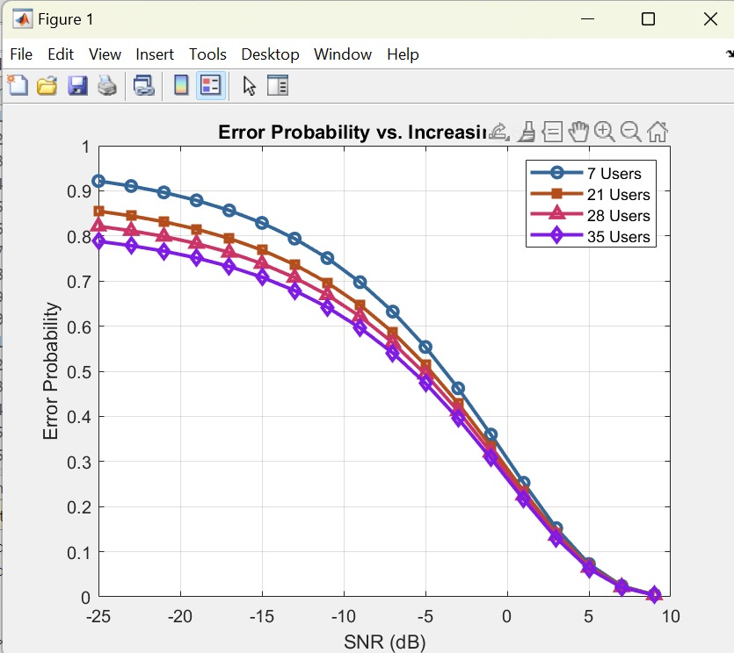
OUTPUT OF FLOWER POLLINATION ALGORITHM

Slide 12
LINEAR WEIGHTED ALGORITHM
The Linear Weighted Algorithm (LWA) is a technique utilized in network communicate among users.
It assigns weights to various parameters such as distance and network traffic to determine the most efficient routes for data exchange.
Clustering techniques are integrated into LWA to enhance its efficiency and scalability.
By grouping network nodes into clusters based on LWA reduces the complexity and improves the accuracy of route selection.
LWA assigns weights to different parameters based on their significance.
These weights are adjusted based on real-time network conditions.
Linear Weighted Algorithm Overview
Optimization through Clustering
Parameter Weighting
for Optimization

Slide 13
LINEAR WEIGHTED ALGORITHM
Using the weighted parameters, LWA calculates the most suitable paths for data transmission between users within the network.
This process involves evaluating multiple factors, including signal strength, available bandwidth, to determine the optimal route.
LWA continuously monitors network conditions and adapts its routing decisions accordingly.
By updating parameter weights and cluster configurations in response to changes in traffic patterns and node availability, LWA ensures efficient data transmission and reception.
Through its integration of clustering techniques and dynamic parameter weighting, LWA offers scalability making it suitable for large-scale network deployments.
Its ability to optimize data transmission routes enhances overall network efficiency and reliability.
Path
Selection &
Routing
Adaptation to Network Changes
Scalability and Performance

Slide 14
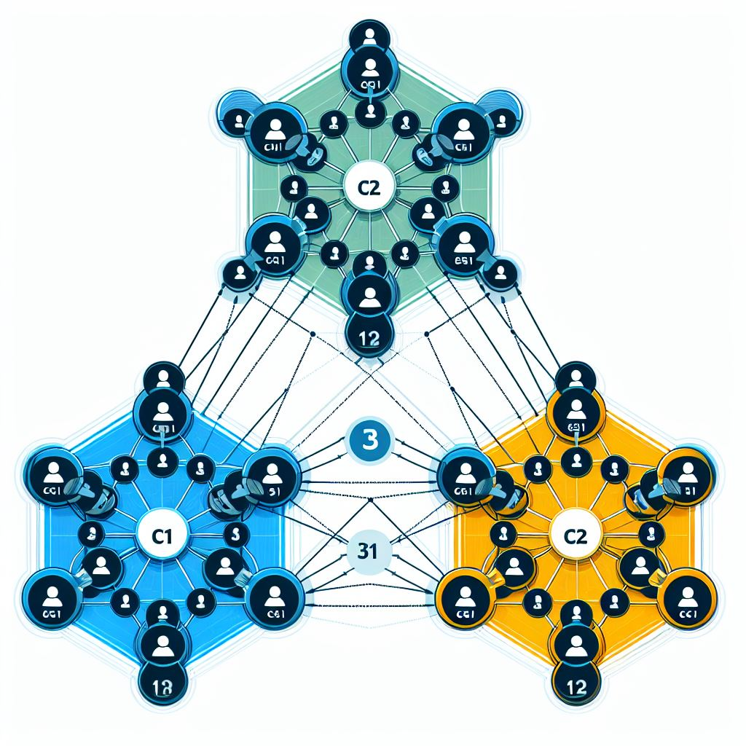
VISUALIZATION
OF
OLWA

Slide 15
Start
Form cluster heads
FLOW CHART OF LINEAR WEIGHTS
Allocate the number of users based upon weighing coefficients
Calculate error probability and SNR based upon the number of users
Stop

Slide 16
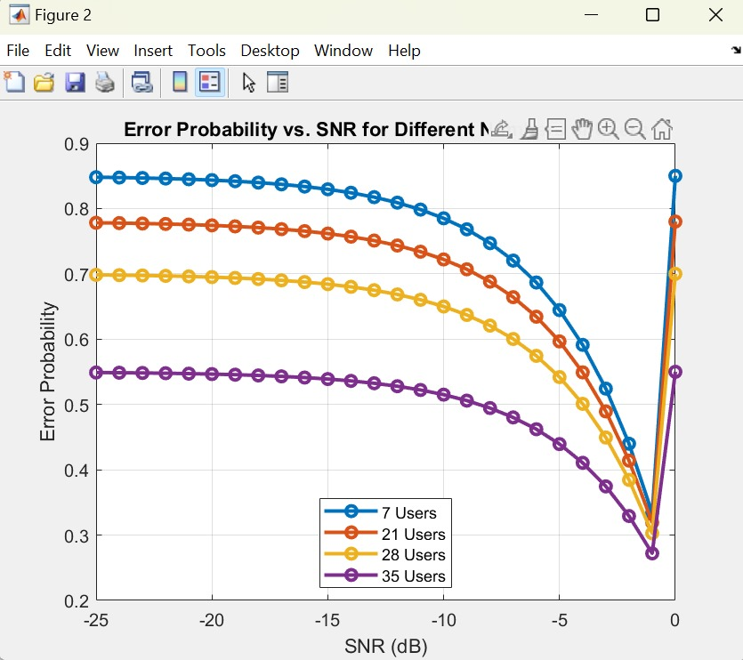
OUTPUT OF LINEAR WEIGHTED ALGORITHM

Slide 17
COMPARISON OF OUTPUTS
OUTPUT OF FLOWER POLLINATION ALGORITHM | OUTPUT OF LINEAR WEIGHTED ALGORITHM

Slide 18
CONCLUSION
The Flower Pollination Algorithm (FPA) and the Optimal Linear Weighted Algorithm (OLWA) are two methods used in managing resources in Cognitive Radio Networks (CRNs).
When we compare them using graphs, we see that they both have similar error rates. For example, with 7 users, FPA has an error rate of 0.92, while OLWA has a slightly lower rate of 0.85. This pattern continues as we add more users.
Interestingly, OLWA becomes more flexible. OLWA can adapt well to different situations without needing complex calculations like FPA.
By comparing these algorithms, researchers can choose the best one for each situation, helping CRNs work more effectively and reliably in real-time.

Slide 19

APPLICATIONS
In Industrial IoT (Internet of Things) applications, the integration of FPA and OLWA presents significant advantages.
As the error probability decreases with increasing SNR, these algorithms enhance spectrum utilization and channel allocation efficiency.
In real-time scenarios, such advancements translate into optimized wireless communication, enabling seamless data exchange and control in industrial environments.
This facilitates tasks like remote monitoring of machinery health, predictive maintenance scheduling, and efficient resource allocation, ultimately improving operational efficiency and reducing downtime in industrial processes.

Slide 20
FUTURE SCOPE
Can be developed using Machine learning algorithms to improve the management of Wireless Networks.
OLWA can be further analyzed to optimize efficiently like adding security measures and making it easier for complex applications to function.

Slide 21
THANK YOU!

